Slide 1
Creation Cost Minimization
11612126 李可明

Slide 2
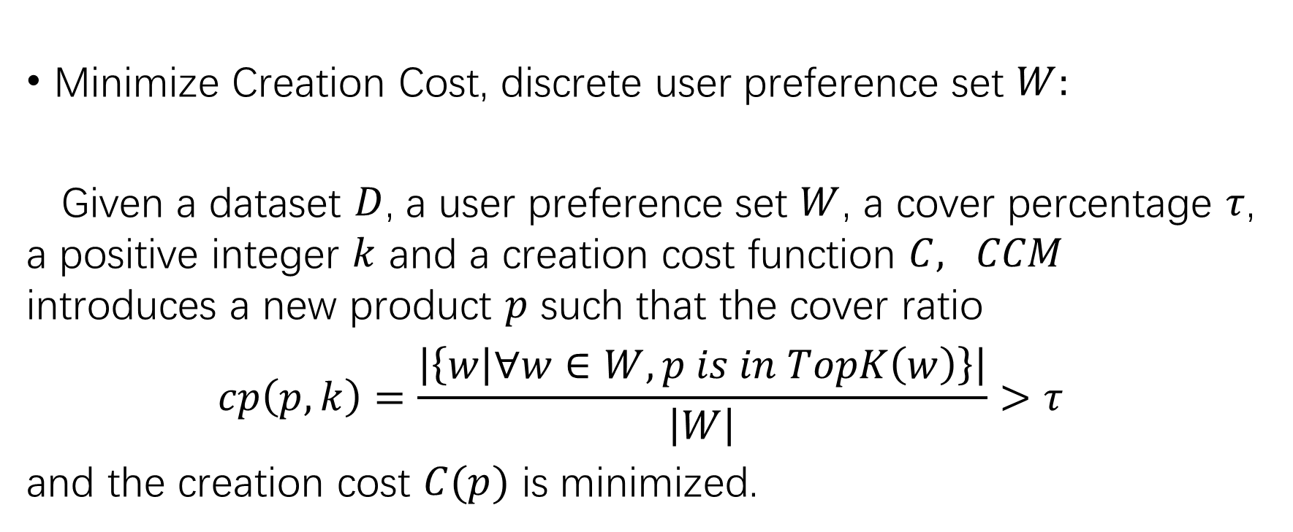
Problem 1
Minimize Creation Cost, discrete user preference set $W:$
Given a dataset $D$, a user preference set $W$, a cover percentage $τ$, a positive integer $k$ and a creation cost function $C, CCM$ introduces a new product $p$ such that the cover ratio
$$cp\left(p, k\right)=\frac{\left|\left\{w | ∀w∈W, p is in TopK\left(w\right)\right\}\right|}{\left|W\right|}>τ$$
and the creation cost $C(p)$ is minimized.

Slide 3
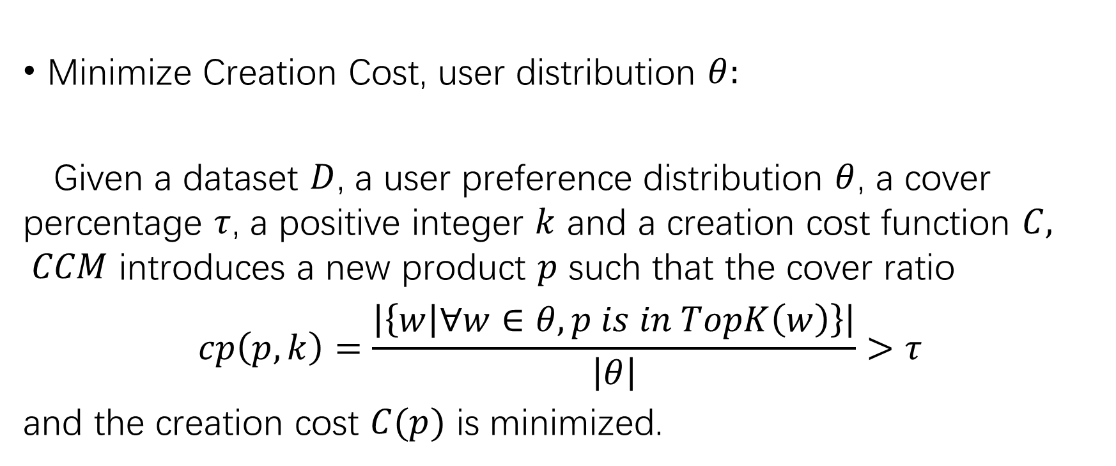
Problem 2
Minimize Creation Cost, user distribution $θ:$
Given a dataset $D$, a user preference distribution $θ$, a cover percentage $τ$, a positive integer $k$ and a creation cost function $C, CCM$ introduces a new product $p$ such that the cover ratio
$$cp\left(p, k\right)=\frac{\left|\left\{w | ∀w∈θ, p is in TopK\left(w\right)\right\}\right|}{\left|θ\right|}>τ$$
and the creation cost $C(p)$ is minimized.

Slide 4
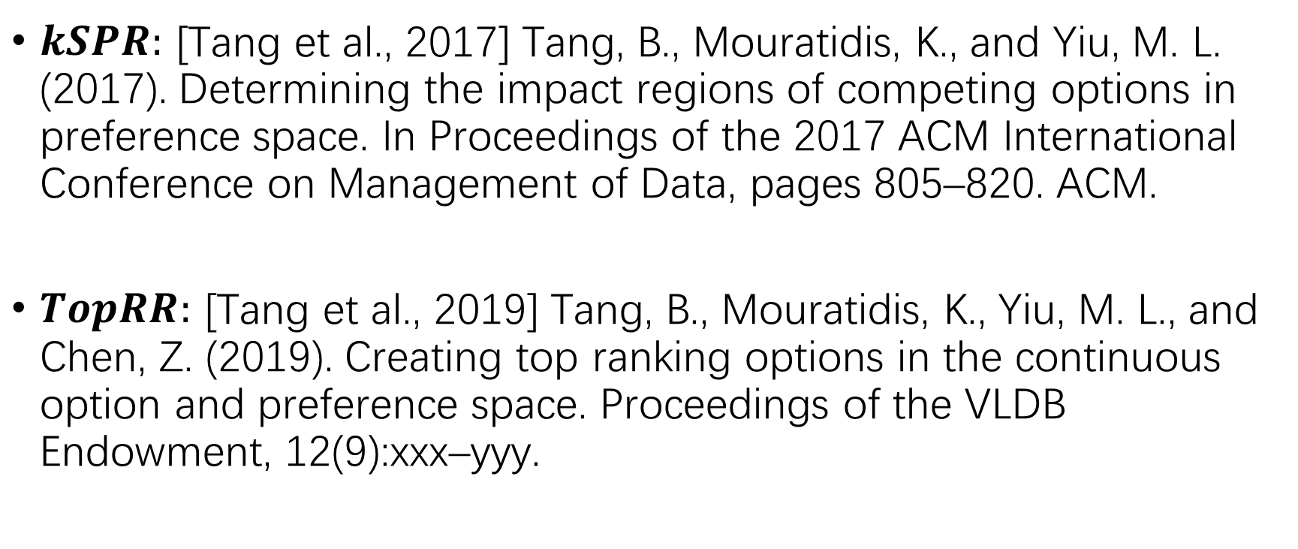
For this week: reading 2 papers
$kSPR:$ [Tang et al., 2017] Tang, B., Mouratidis, K., and Yiu, M. L. (2017). Determining the impact regions of competing options in preference space. In Proceedings of the 2017 ACM International Conference on Management of Data, pages 805–820. ACM.
$TopRR:$ [Tang et al., 2019] Tang, B., Mouratidis, K., Yiu, M. L., and Chen, Z. (2019). Creating top ranking options in the continuous option and preference space. Proceedings of the VLDB Endowment, 12(9):xxx–yyy.

Slide 5
kSPR

Slide 6


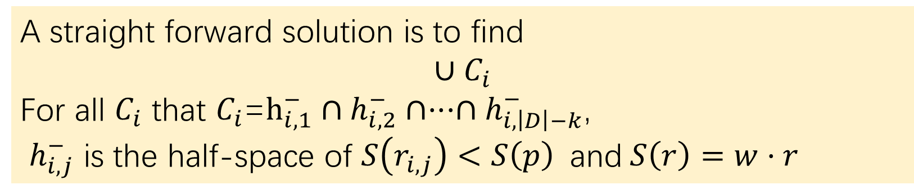
$kSPR$-Problem Definition
The k-Shortlist Preference Region problem ($kSPR$) takes as input a dataset $D$,
a focal record $p=\left(p_{1}, p_{2}, ···, p_{d}\right),$
and an integer$k$.
It reports all the regions in preference space where if the weight vector lies, $p$ranks among the top-k records.
A straight forward solution is to find
$$∪C_{i}$$
For all $C_{i}$ that $C_{i}$=$h_{i,1}^{−}∩h_{i,2}^{−}∩···∩h_{i, \left|D\right|−k}^{−}$,
$h_{i,j}^{−}$ is the half-space of $S\left(r_{i,j}\right)<S\left(p\right)$and$S\left(r\right)=w·r$

Slide 7
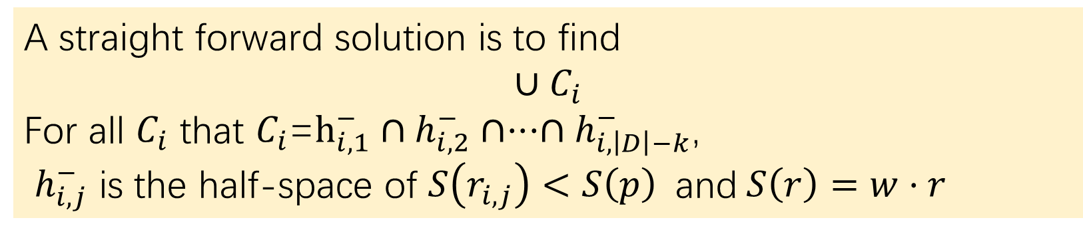
$kSPR$-Problem Definition
A straight forward solution is to find
$$∪C_{i}$$
For all $C_{i}$ that $C_{i}$=$h_{i,1}^{−}∩h_{i,2}^{−}∩···∩h_{i, \left|D\right|−k}^{−}$,
$h_{i,j}^{−}$ is the half-space of $S\left(r_{i,j}\right)<S\left(p\right)$and$S\left(r\right)=w·r$
在一个半空间内表明p比一个r分数高， 只要p在至少|D|-k个半空间内它必能排前k(D包含p)
而这|D|-k个半空间是从|D|-1个半空间组合， 只要将所有结果取并集就是最后结果， 时间复杂度为组合数

Slide 8
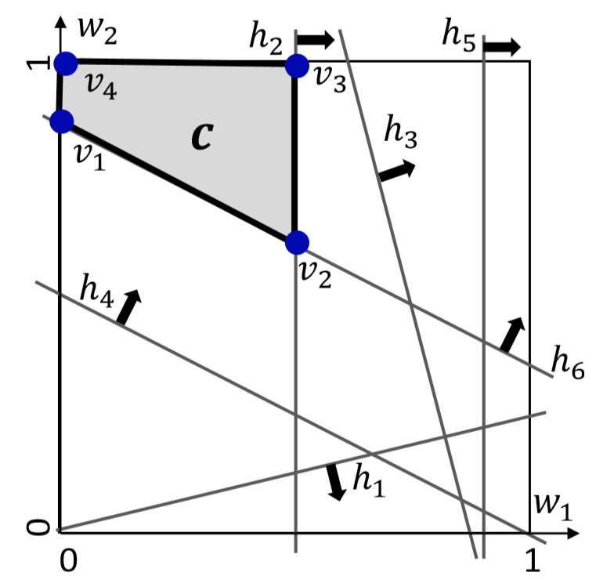
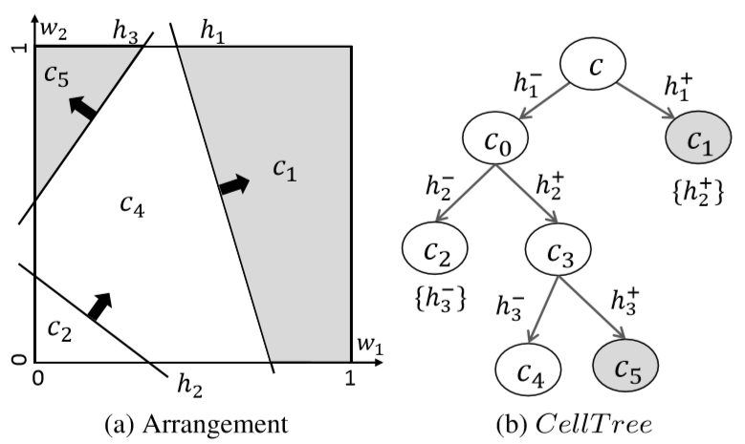


$kSPR$-$CTA$
Cell $c$ is defined as
$h_{1}^{−}∩h_{2}^{−}∩$ $h_{3}^{−}∩$ $h_{4}^{+}∩$ $h_{5}^{−}∩h_{6}^{+}$
剪枝:
- 数halfspaces数
- 利用option之间的domination关系
- ···

Slide 9
TopRR

Slide 10

TopRR: problem definition
Given a dataset $D,$
a positive integer $k,$
and a preference region $wR⊂ W,$
compute the maximal region $oR$ in option space where a new option $o$ should lie, so that it is a top-ranking option.

Slide 11
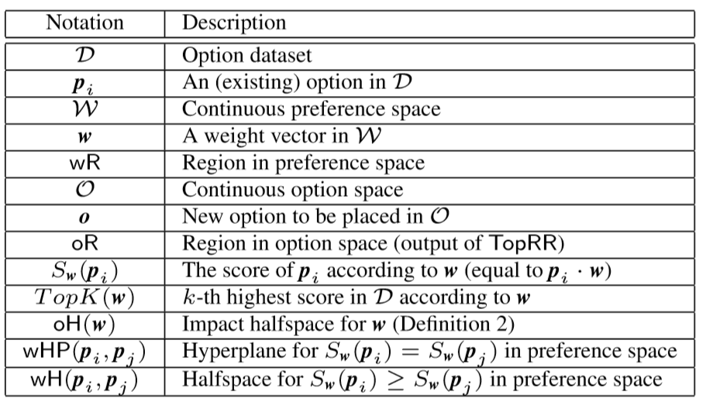
TopRR: Notation

Slide 12
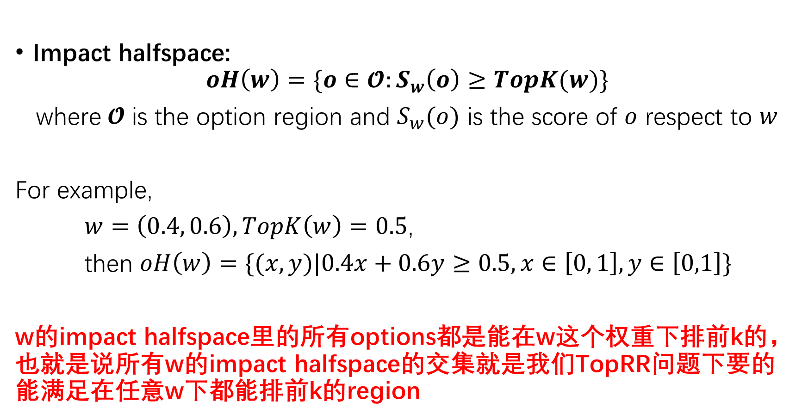
TopRR:
Impact halfspace:
$$oH\left(w\right)=\{o∈𝓞:S_{w}\left(o\right)≥TopK(w)\}$$
where$𝓞$ is the option region and $S_{w}(o)$ is the score of $o$ respect to $w$
For example,
$w=\left(0.4, 0.6\right), TopK\left(w\right)=0.5$,
then $oH\left(w\right)=\{(x,y)|0.4x+0.6y≥0.5, x∈\left[0, 1\right], y∈\left[0,1\right]\}$
w的impact halfspace里的所有options都是能在w这个权重下排前k的， 也就是说所有w的impact halfspace的交集就是我们TopRR问题下要的能满足在任意w下都能排前k的region

Slide 13
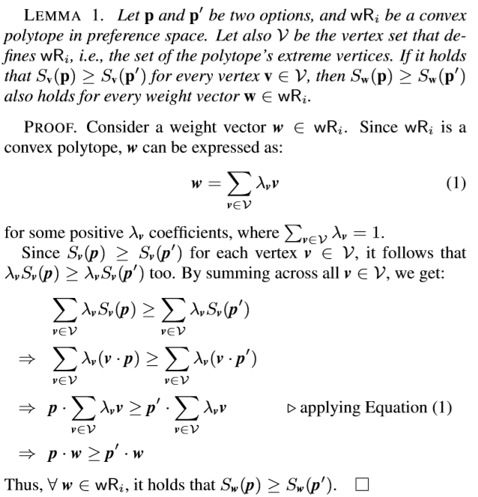
TopRR

Slide 14
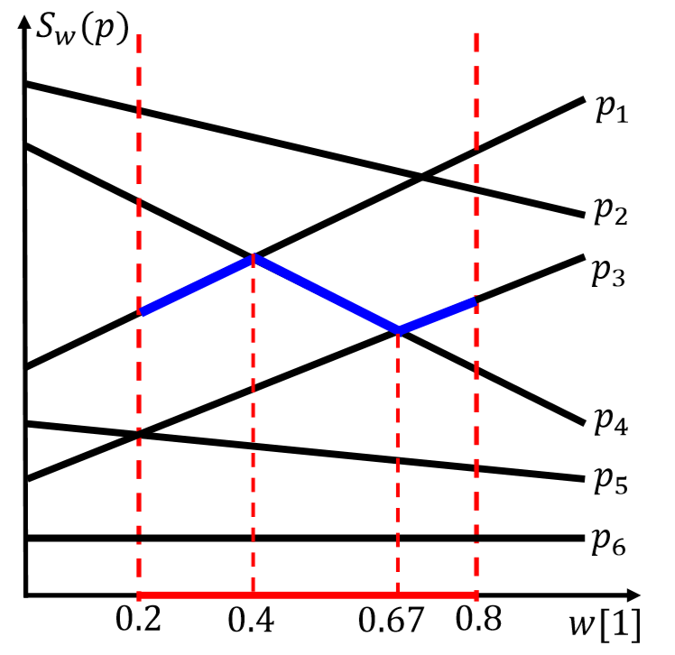

TopRR:
kIPR, RANK-k INVARIAN PREFERENCE REGION:
A region $wRi$ in preference space is a rank-k invariant preference region (kIPR) if the top-k result for every weight vector
$$w∈wR_{i}$$
comprises the same k options, and
the top-k-th option is always the same.
As shown in the figure, region [0.2, 0.8] and [0.2, 0.67]
are not $kIPR$ but region [0.67, 0.8] is.

Slide 15
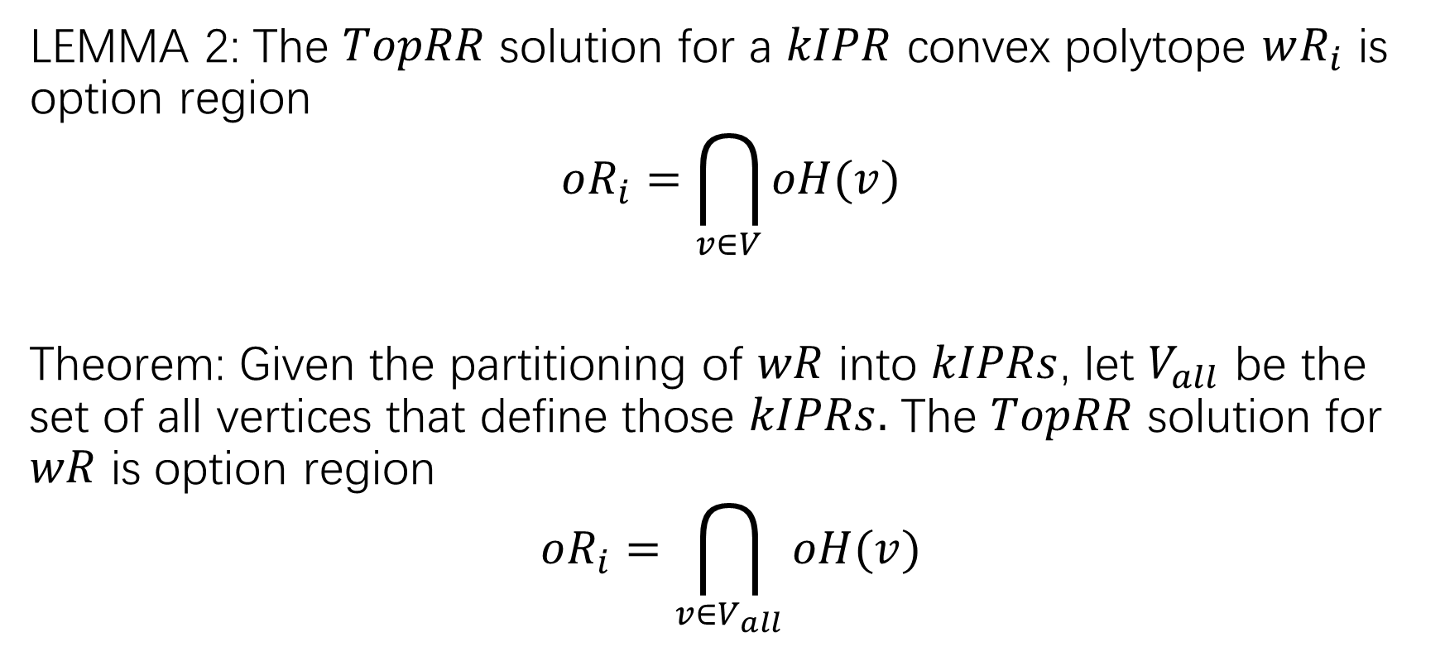
TopRR:
LEMMA 2: The $TopRR$ solution for a $kIPR$ convex polytope $wR_{i}$ is option region
$$oR_{i}=\bigcap_{v∈V}{oH(v)}$$
Theorem: Given the partitioning of $wR$ into $kIPRs$, let $V_{all}$ be the set of all vertices that define those $kIPRs.$ The $TopRR$ solution for $wR$ is option region
$$oR_{i}=\bigcap_{v∈V_{all}}{oH(v)}$$

Slide 16
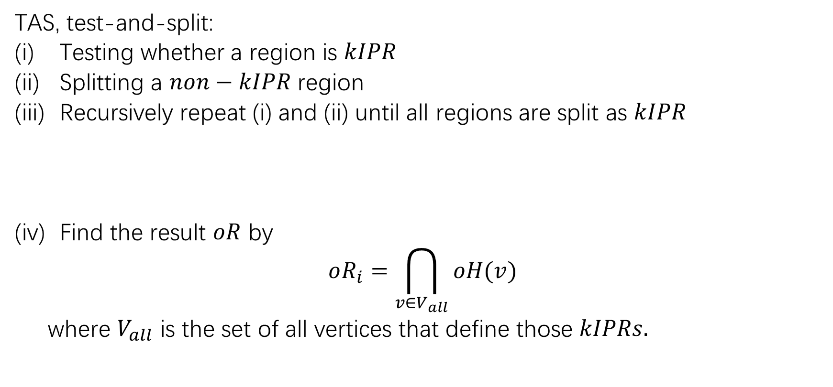
TopRR:
TAS, test-and-split:
Testing whether a region is $kIPR$
Splitting a $non−kIPR$ region
Recursively repeat (i) and (ii) until all regions are split as $kIPR$
Find the result $oR$ by
$$oR_{i}=\bigcap_{v∈V_{all}}{oH(v)}$$
where $V_{all}$ is the set of all vertices that define those $kIPRs.$

